Slide 1
Module 4 Semiconductor devices

Slide 2

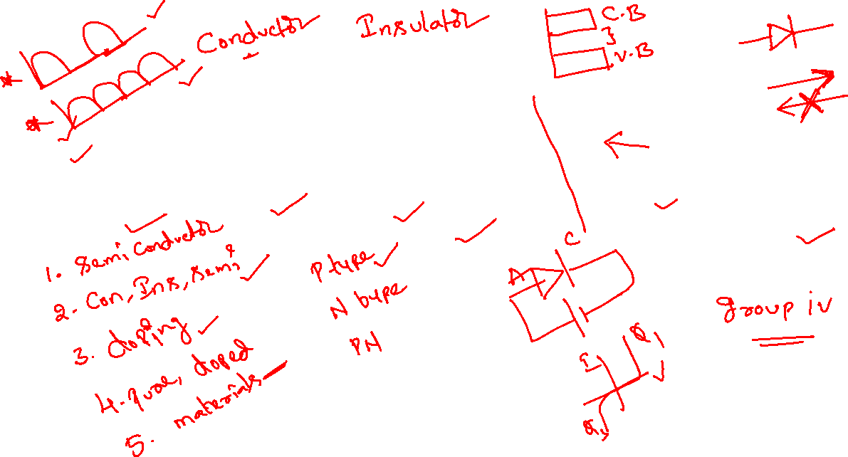
Overview
Semiconductor Theory
PN Junction
PN Junction Diode
Application of Diode – HW & FW Rectifier
Zenor Diode
Application of Zenor Diode – Voltage Regulator

Slide 3


5. Zenor diode

Slide 4
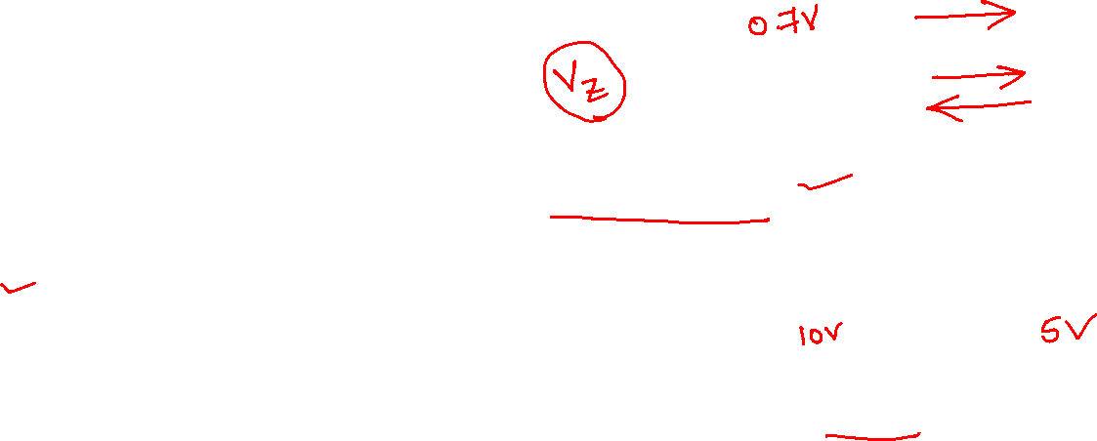
Zenor Diode
Zener diodes, also known as breakdown diodes are heavily doped semiconductor devices that are designed to operate in the reverse direction.
When the voltage across its terminals is reversed and the potential reaches the Zener Voltage (knee voltage), the junction will break down and the current flows in the reverse direction.
This effect is known as the Zener Effect.
Zener diodes are manufactured with a great variety of Zener voltages (Vz) and some are even made variable.

Slide 5
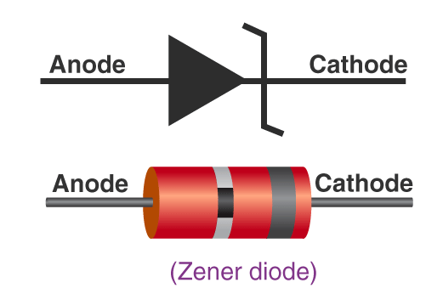
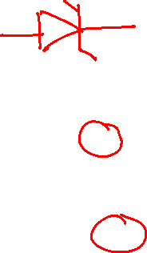
Zener Diode Circuit Symbol
The Zener diode circuit symbol places two tags at the end of the bar – one in the upward direction and the other in the lower direction as shown in the figure.
This helps in distinguishing Zener diodes from other forms of diodes within the circuit.

Slide 6
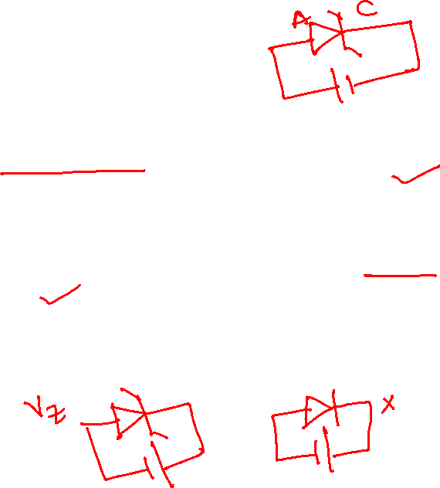
Working of Zener Diode
The Zener diode operates just like a normal diode when it is forward-biased.
However, when connected in reverse biased mode, a small leakage current flows through the diode.
As the reverse voltage increases to the predetermined breakdown voltage (Vz), a current starts flowing through the diode.
The current increases to a maximum, which is determined by the series resistor, after which it stabilizes and remains constant over a wide range of applied voltage.

Slide 7
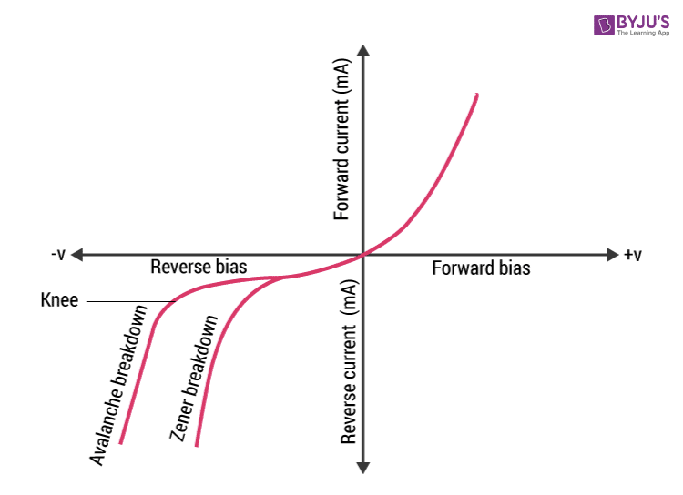
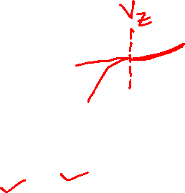
V-I Characteristics of Zener Diode
When reverse-biased voltage is applied to a Zener diode, it allows only a small amount of leakage current until the voltage is less than Zener voltage.

Slide 8
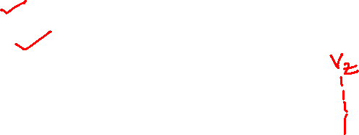
types of breakdown
For a Zener diode there are two types of breakdown:
Zener breakdown
Avalanche breakdown

Slide 9
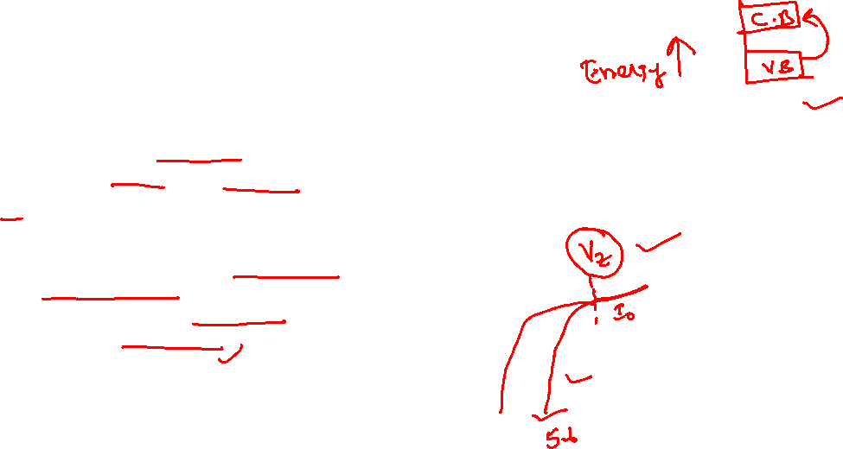
Zener Breakdown vs Avalanche Breakdown
The Zener effect is dominant in voltages up to 5.6 volts and the avalanche effect takes over above that.
They are both similar effects, the difference being that the Zener effect is a quantum phenomenon and the avalanche effect is the movement of electrons in the valence band like in any electric current.
Avalanche effect also allows a larger current through the diode than the Zener effect

Slide 10
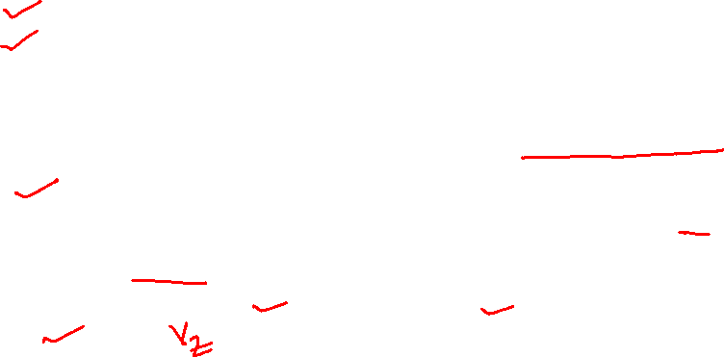
V-I characteristics of a Zener diode
The V-I characteristics of a Zener diode can be divided into two parts as follows:
Forward Characteristics
Reverse Characteristics
Forward Characteristics
The first quadrant in the graph represents the forward characteristics of a Zener diode. From the graph, we understand that it is almost identical to the forward characteristics of any other P-N junction diode.
Reverse Characteristics
When a reverse voltage is applied to a Zener voltage, initially a small reverse saturation current Io flows across the diode. This current is due to thermally generated minority carriers. As the reverse voltage is increased, at a certain value of reverse voltage, the reverse current increases drastically and sharply. This is an indication that the breakdown has occurred. We call this voltage breakdown voltage or Zener voltage and it is denoted by Vz.

Slide 11
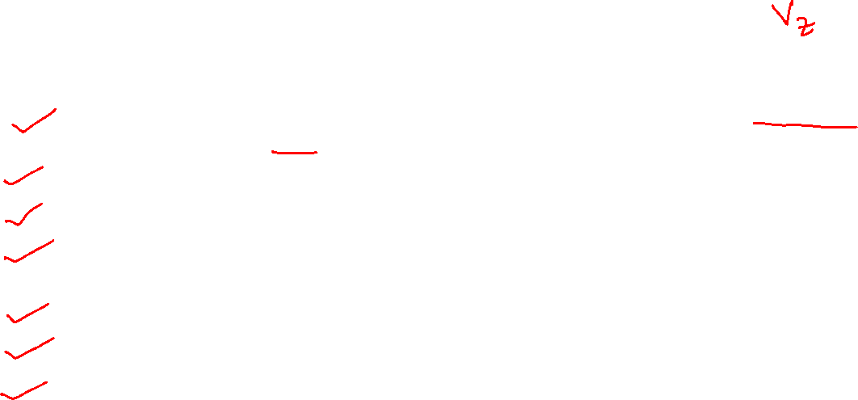
Zener Diode Specifications
Some commonly used specifications for Zener diodes are as follows:
Zener/Breakdown Voltage – The Zener or the reverse breakdown voltage ranges from 2.4 V to 200 V, sometimes it can go up to 1 kV while the maximum for the surface-mounted device is 47 V.
Current Iz (max) – It is the maximum current at the rated Zener Voltage (Vz – 200μA to 200 A)
Current Iz (min) – It is the minimum value of current required for the diode to breakdown.
Power Rating – It denotes the maximum power the Zener diode can dissipate. It is given by the product of the voltage of the diode and the current flowing through it.
Temperature Stability – Diodes around 5 V have the best stability
Voltage Tolerance – It is typically ±5%
Zener Resistance (Rz) – It is the resistance to the Zener diode exhibits.

Slide 12

advantages of a Zener diode
The size of the Zener diode is so small that it can be used in smaller circuits and also in cell phones.
Zener diodes are less expensive when compared to other diodes.
Zener diodes can be used for controlling, regulating, and stabilizing the voltage in the circuit.
These diodes have a very high-performance standard.
The compatibility of the Zener diodes is good that they are used in regulating voltage.

Slide 13
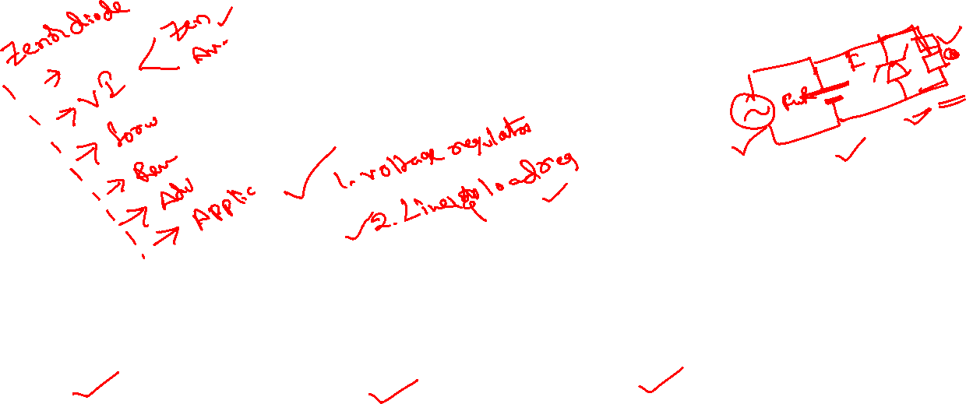
Application of Zener Diode
Zener diode as a voltage regulator
Zener diode in over-voltage protection
Zener diode in clipping circuits

Slide 14
6. Application of Zenor diode – Voltage Regulator

Slide 15
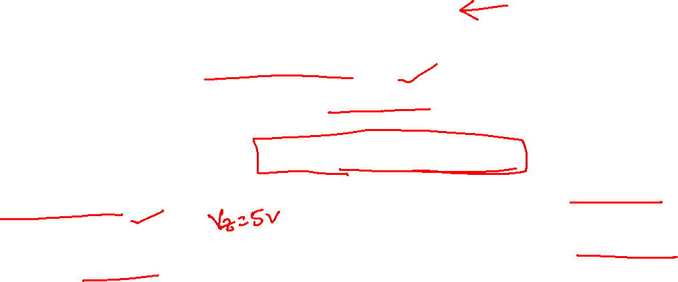
Zener Diode as a Voltage Regulator
Zener diode is a silicon semiconductor with a p-n junction that is specifically designed to work in the reverse biased condition.
When forward biased, it behaves like a normal signal diode, but when the reverse voltage is applied to it, the voltage remains constant for a wide range of currents.
Due to this feature, it is used as a voltage regulator in d.c. circuit.
The primary objective of the Zener diode as a voltage regulator is to maintain a constant voltage.
Let us say if Zener voltage of 5 V is used then, the voltage becomes constant at 5 V, and it does not change.

Slide 16
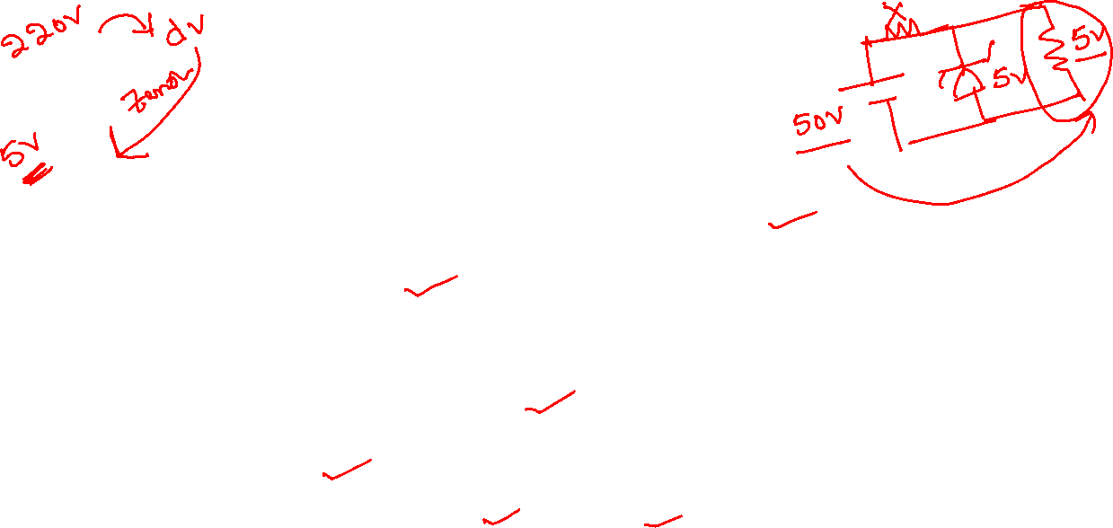
What is a Voltage Regulator
A voltage regulator is a device that regulates the voltage level.
It essentially steps down the input voltage to the desired level and keeps it at that same level during the supply.
This ensures that even when a load is applied the voltage doesn’t drop.
The voltage regulator is used for two main reasons, and they are:
To vary or regulate the output voltage
To keep the output voltage constant at the desired value in spite of variations in the supply voltage.
Voltage regulators are used in computers, power generators, alternators to control the output of the plant.

Slide 17
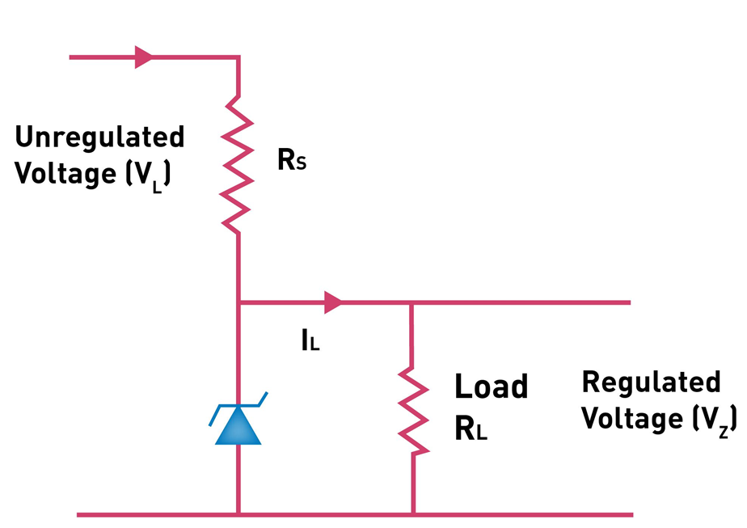
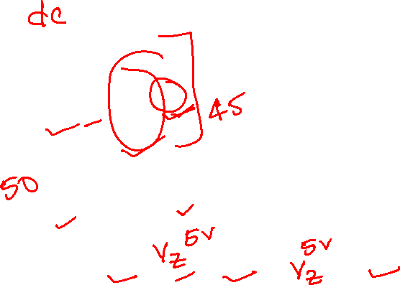
Zener Diode as a Voltage Regulator
The circuit diagram of a voltage regulator using a Zener diode.
There is a series resistor connected to the circuit in order to limit the current into the diode.
It is connected to the positive terminal of the d.c. It works in such a way the reverse-biased can also work in breakdown conditions.
We do not use ordinary junction diode because the low power rating diode can get damaged when we apply reverse bias above its breakdown voltage.
When the minimum input voltage and the maximum load current is applied, the Zener diode current should always be minimum.

Slide 18
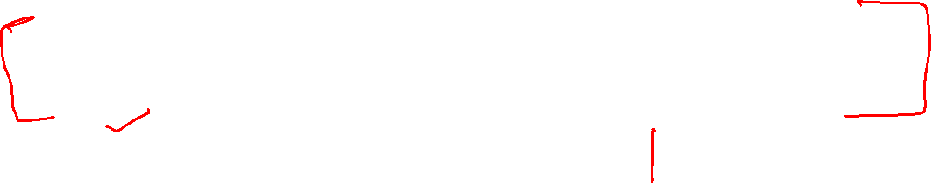
Operation
Since the input voltage and the required output voltage is known, it is easier to choose a Zener diode with a voltage approximately equal to the load voltage, i.e. VZ = VL.
The value of the series resistor is written as RS = (VL − VZ)IL
Current through the diode increases when the voltage across the diode tends to increase which results in the voltage drop across the resistor.
Similarly, the current through the diode decreases when the voltage across the diode tends to decrease. Here, the voltage drop across the resistor is very less, and the output voltage results normally.

Slide 19
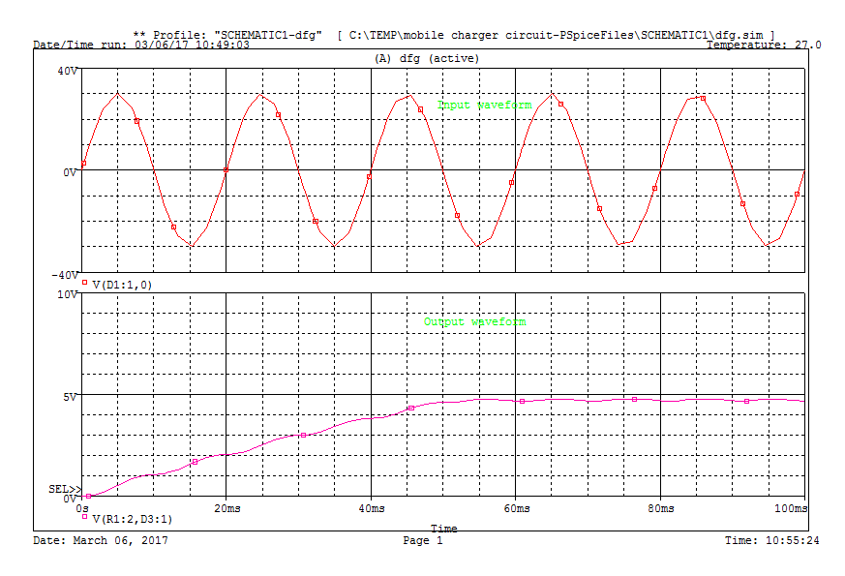
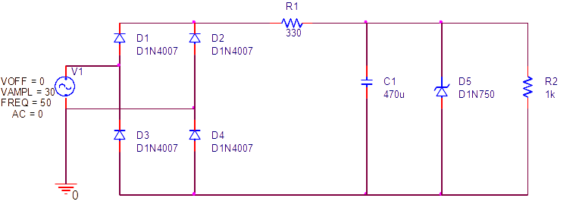
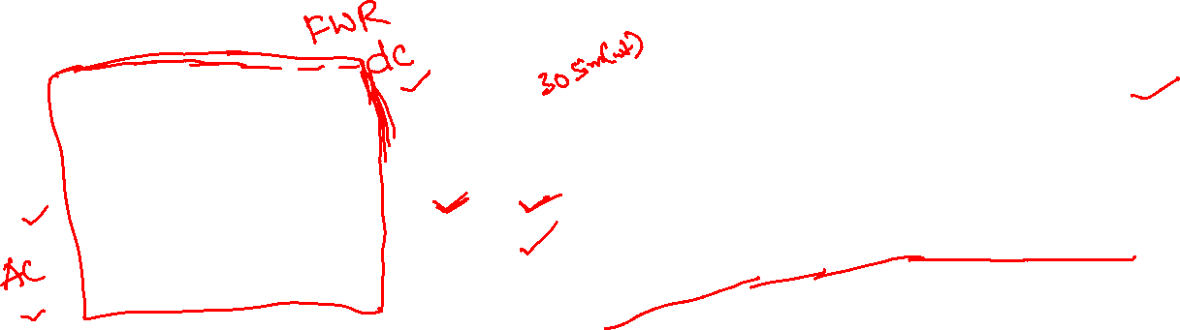
Experiment

Slide 20

quiz
What is the level of doping in Zener Diode?
a) Lightly Doped
b) Heavily Doped
c) Moderately Doped
d) No doping

Slide 21
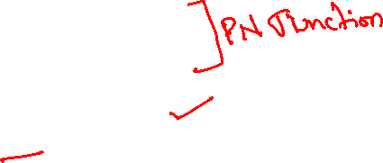
QUIZ
Zener Diode is mostly used as ____________
a) Half-wave rectifier
b) Full-wave rectifier
c) Voltage Regulator
d) LED

Slide 22
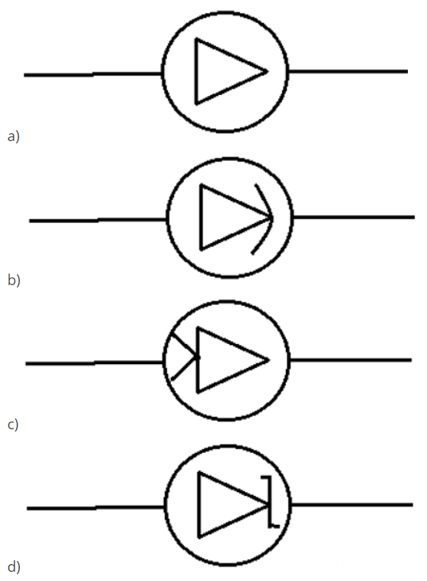

quiz
Which of the following is the correct symbol for the zener diode?

Slide 23
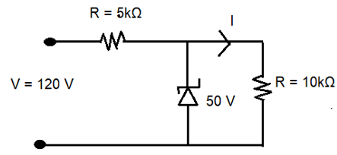
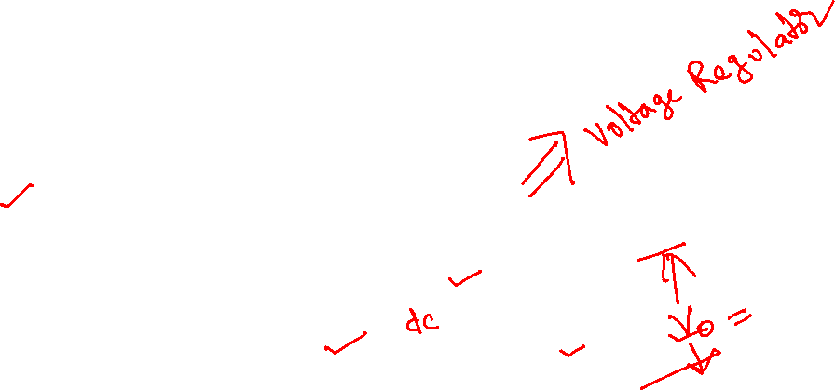
quiz
In the circuit, what is the output voltage?
a) 50 V
b) 70 V
c) 120 V
d) 170 V

Slide 24
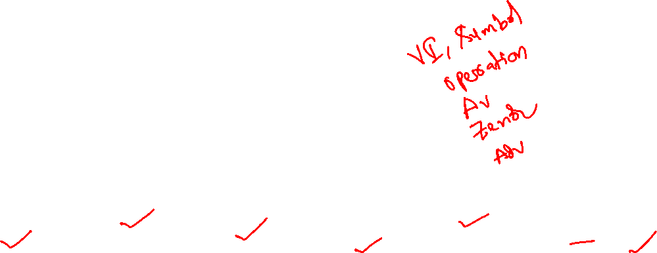
END OF Module
Semiconductor Theory
PN Junction
PN Junction Diode
Application of Diode – HW & FW Rectifier
Zenor Diode
Application of Zenor Diode – Voltage Regulator

